Slide 1

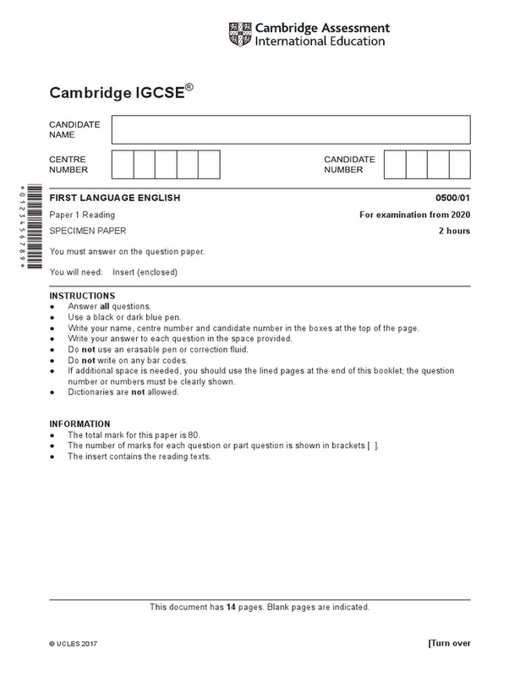










LO: To Understand FLE Writing Paper 2 - Q2 Descriptive Writing

Slide 2

Show - don’t tell is a common target for students when descriptive writing.
What do you think examiners/ teachers mean by this?
Was this one of your targets in year 9 when writing your short story?
Notes:
2 mins for students to discuss

Slide 3
No idea!
Help!
Super confident!
Notes:
Move to side of the room to show how confident you feel on this aspect of descriptive writing - 3 mins. Talk to 2-3 people around you now about why you’ve stood where you have. What do you think it means/ how do you implement it in your descriptive writing?

Slide 4

Notes:
5 mins to watch

Slide 5
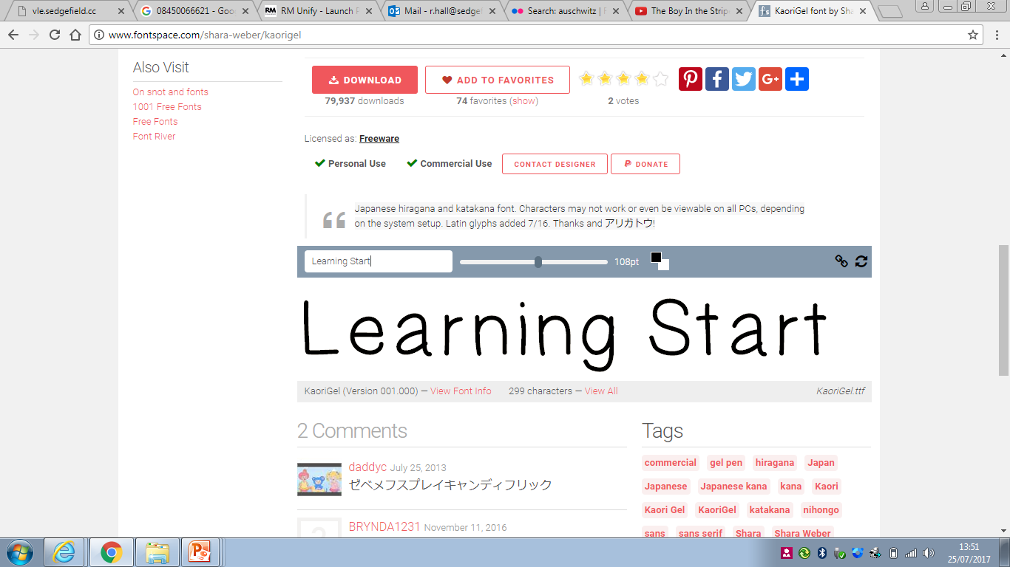
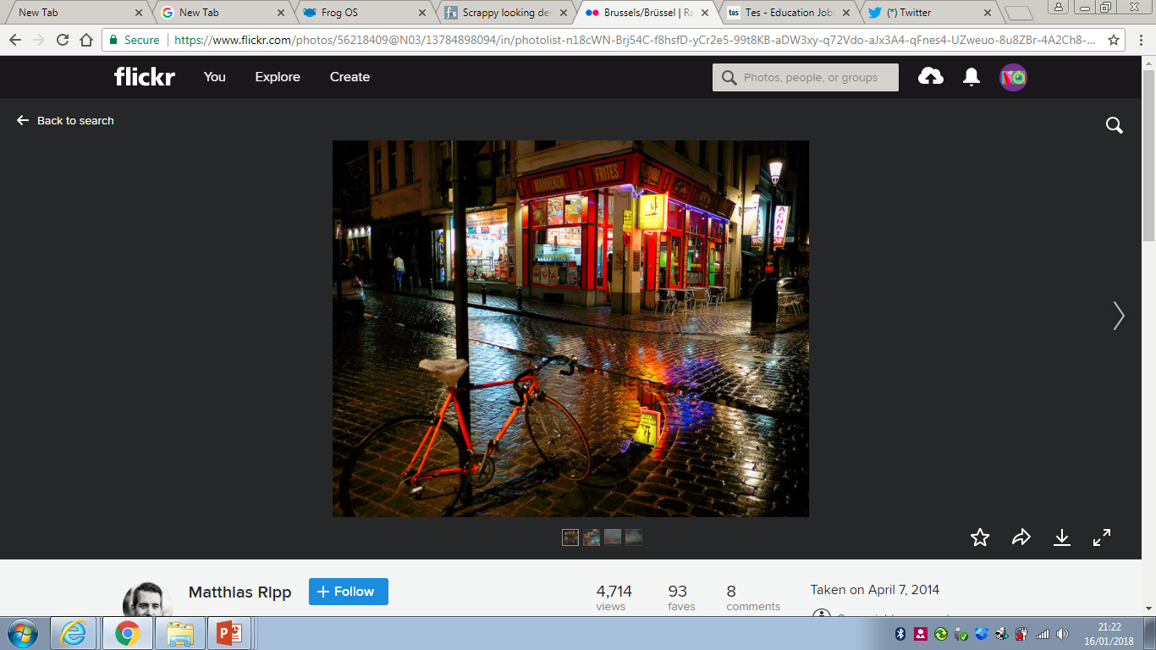
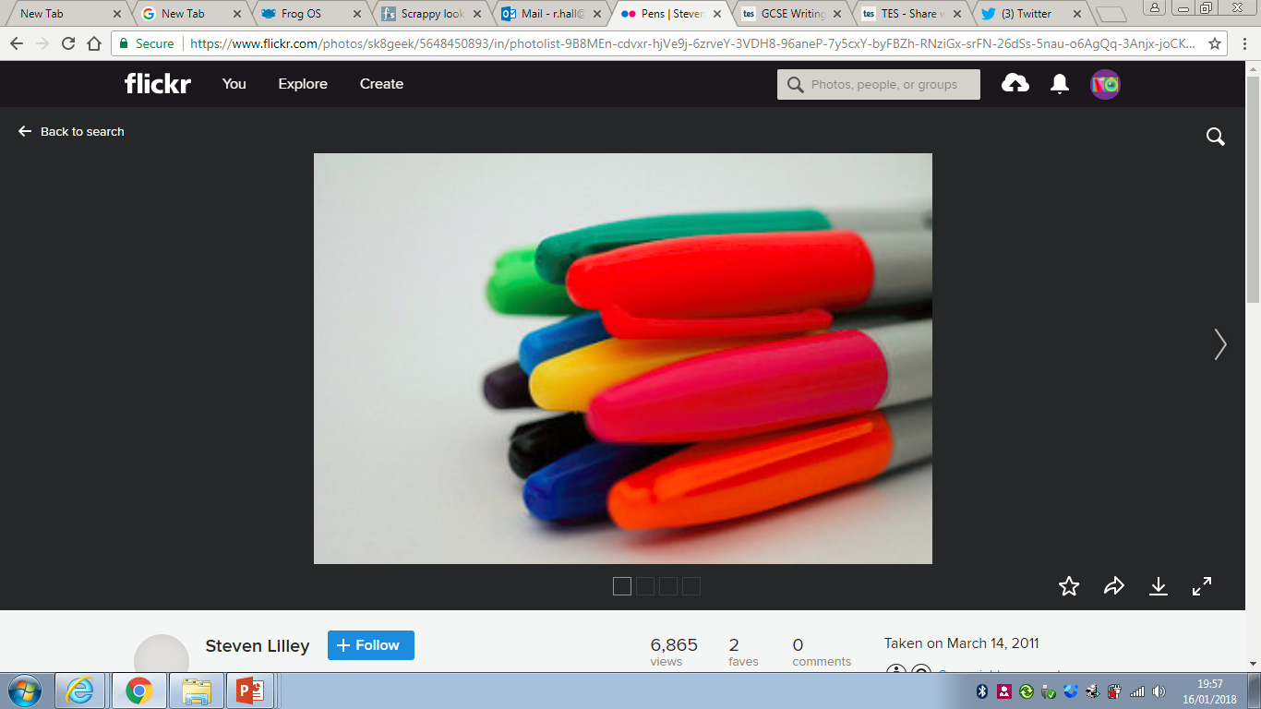
5 Minute Writing Challenge
Slick
First sentence should begin with a preposition
Glassy
Iridescent
Myriad
Include a one line paragraph
Acrid
Prevailing
Gloomy
Third sentence should begin with an adverb
Personify a street light
Describe a faraway sound

Slide 6
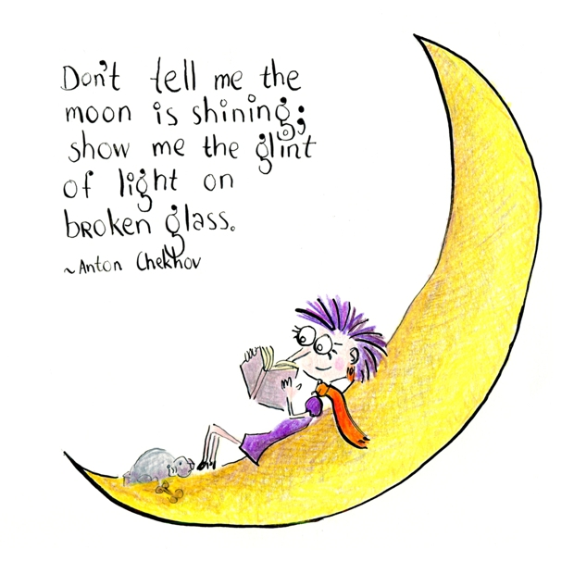
SHOW - DON’T TELL
Allows the reader to experience expository details of the story through actions, sensory details, words, or the expression of characters’ emotions, as opposed to through the author’s own description of events.
The author attempts to show you what is happening through images and action, rather than simply telling you what is happening in narration.
Describes details of the scene, showing us close ups/ zooming in on specific and interesting details (think back to Zoom method).
Notes:
3 mins to read through

Slide 7
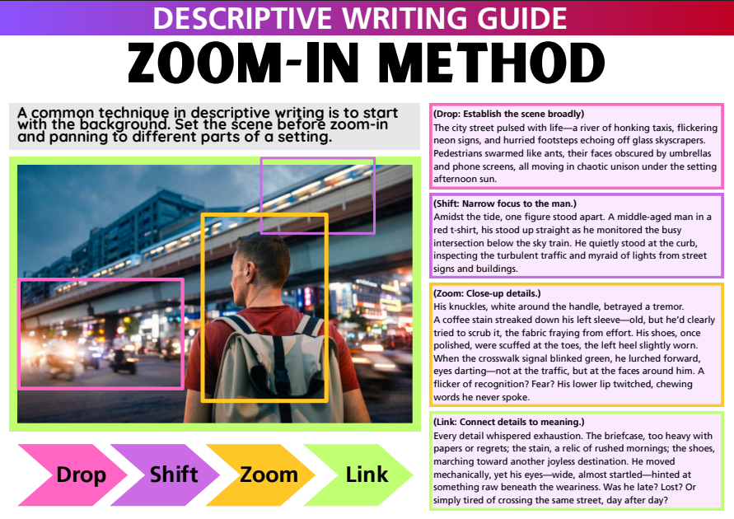
Start Big!
Set the Scene!
Then slowly zoom in

Slide 8
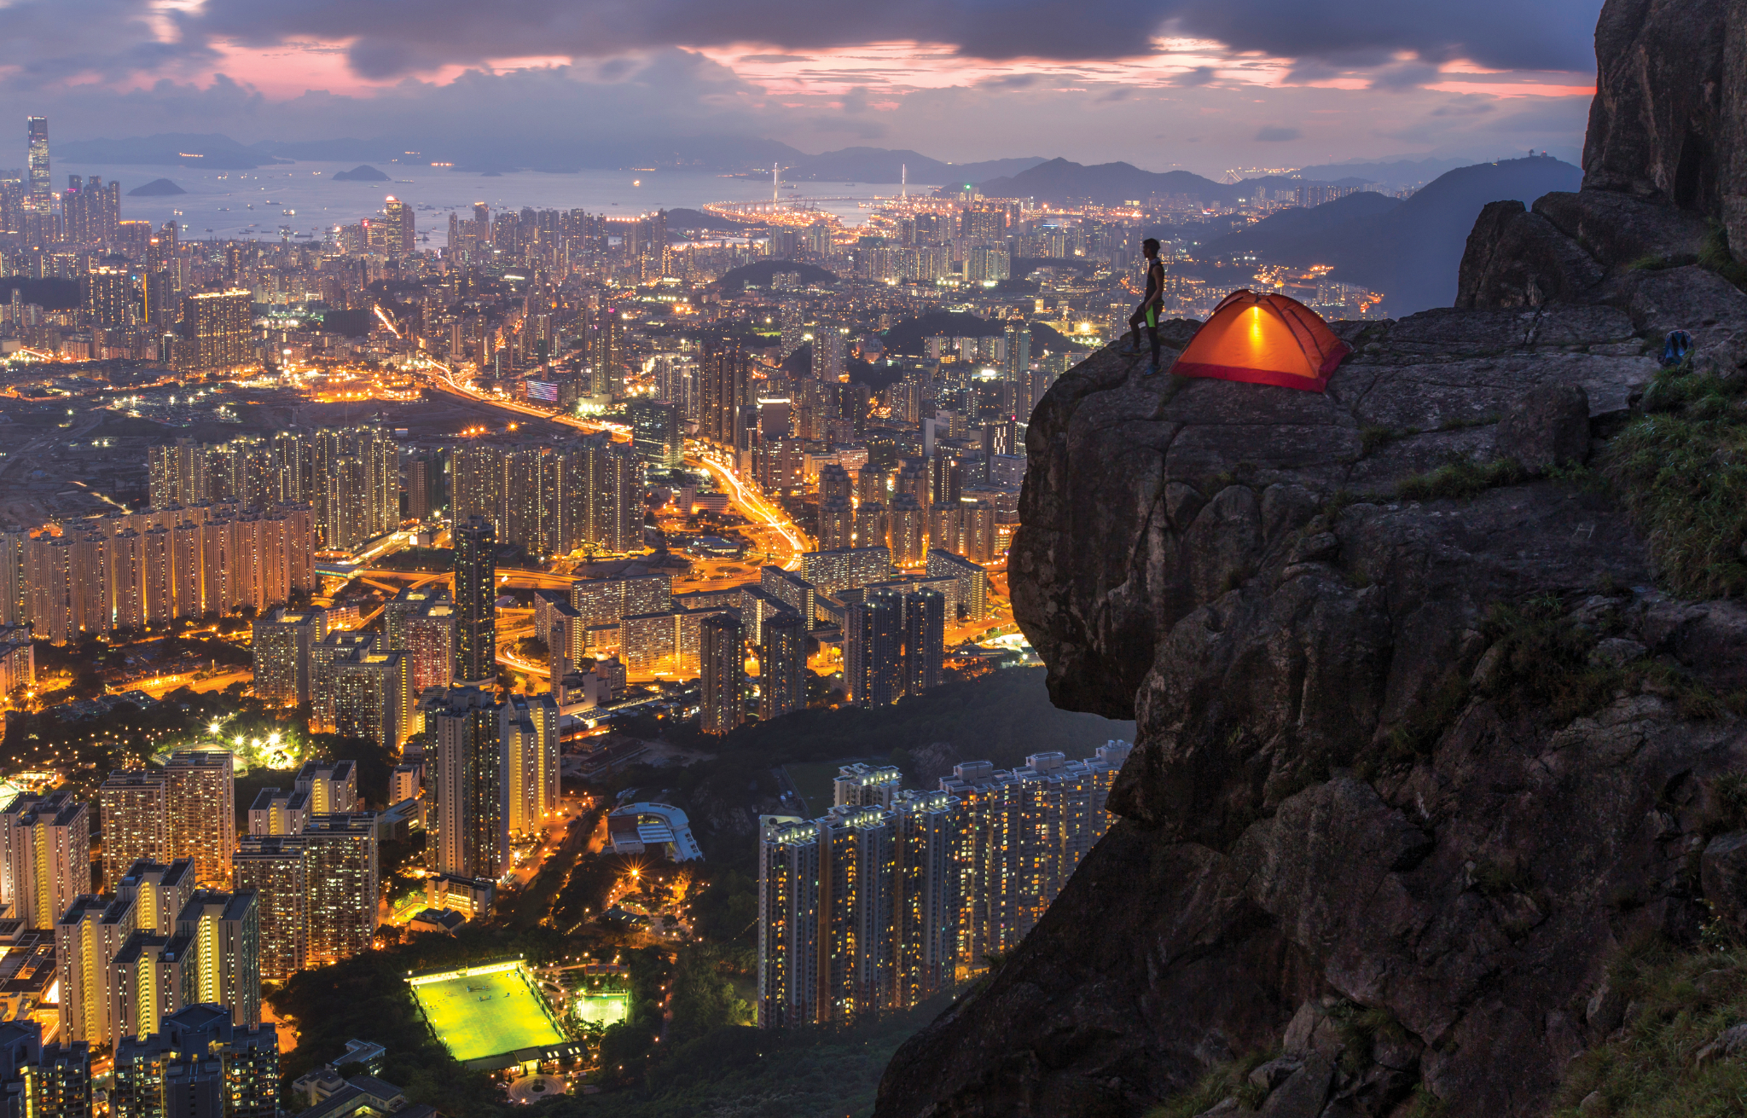
What are the successes and weaknesses in this paragraph about the man and the sky? How could we improve it?
Write a description with the title: The Escape
There were different colours all about the sky. It was getting dark on Kowloon Peak. The city lights far away. I was alone. There was no sound and it was rather chilly. I was tired. I was feeling calm. I felt like I had escaped my problems under the lovely sky.
Notes:
5 mins discussion as a class

Slide 9

GROUP TASK: Work together to rewrite the paragraph on A3 paper, aiming to SHOW, not tell.
Write a description with the title: The Escape
Success criteria:
Must have some focus on ‘escape’.
Zoom in on objects/ aspects within the scene - colours? Sounds? Movements?
Show the man’s feelings - actions? Posture?
Add some attention to detail for each object/ aspect of the scene you describe.
Use powerful verbs and adjectives.
Can you include some imagery?
Vary your sentences.
Avoid cliches/ obvious descriptions.
Remember to…
“Show, and not tell!”
Challenge: If you have time, extend into another paragraph, zooming in on the football pitch or the skyscrapers or the rocks of the peak in more detail.
Notes:
15 minutes to rewrite the descriptions on A3 paper as a group

Slide 10
In your English Pink Book, write a description with the title: The Escape
PAIR ACTIVITY! Work with the person sitting next to you!
THINK, PAIR, SHARE
@<<10:00-@>>
Success criteria:
Must have some focus on ‘escape’.
Zoom in on objects/ aspects within the scene - colours? Sounds? Movements?
Show the man’s feelings - actions? Posture?
Add some attention to detail for each object/ aspect of the scene you describe.
Use powerful verbs and adjectives.
Can you include some imagery?
Vary your sentences.
Avoid cliches/ obvious descriptions.
Switch with another pair. How well they have shown the man’s feelings and the evening sky?
Give them a positive comment and a target.
Notes:
5 mins

Slide 11

star
THE STAR SENTENCE
As a group, decide on your ‘star sentence’ to share with the class.
GROUP ACTIVITY
Notes:
3 mins read out

Slide 12
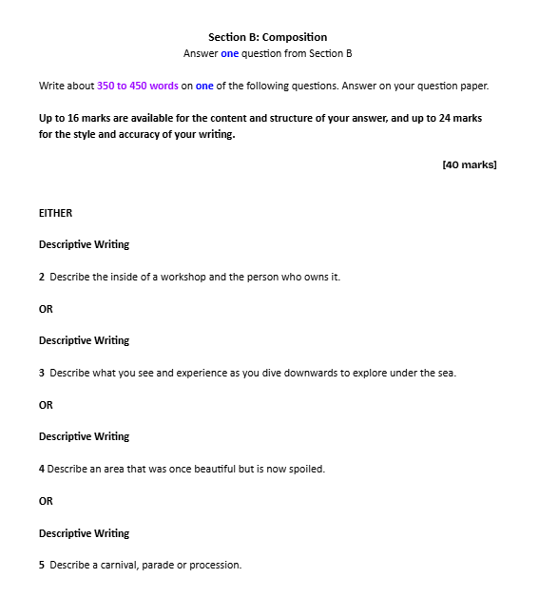
Guiding Prompt provided on Question Paper

Slide 13
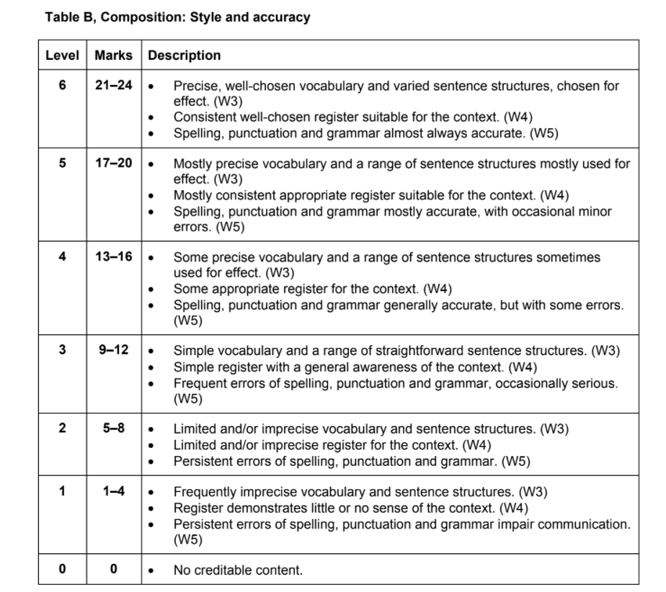
Notes:
2 mins to show and focus more on this next lesson

Slide 14
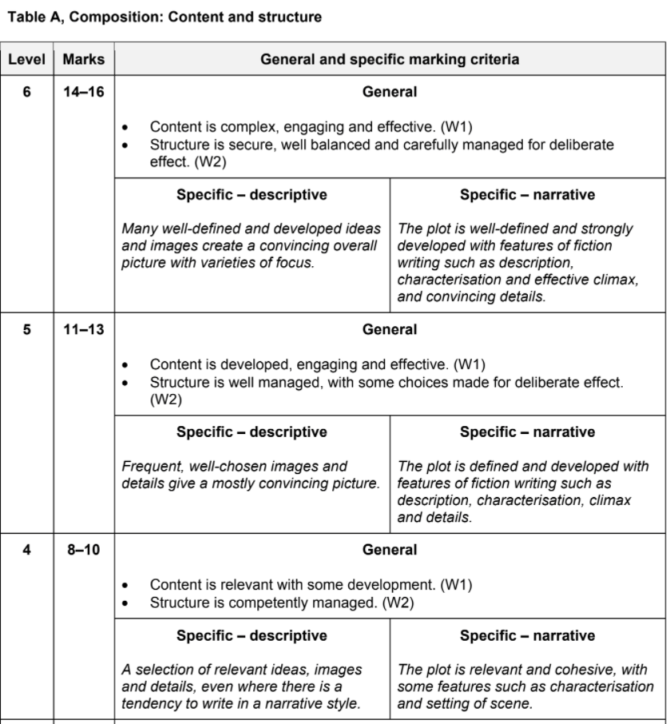

Slide 15
Additional Writing Challenges for Revision
Notes:
3 mins discussion

Slide 16
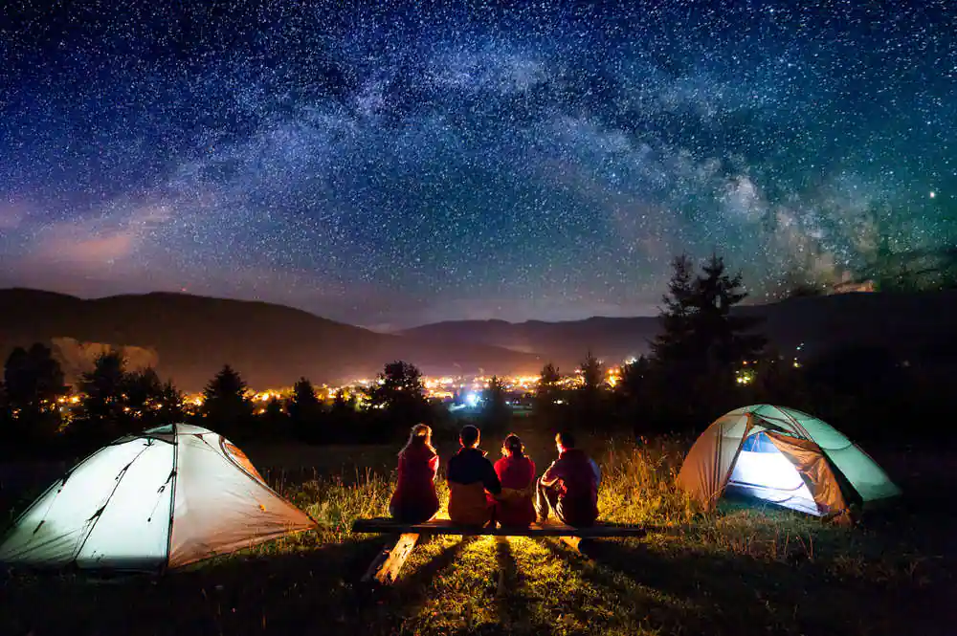
Make a list of the different people and objects you can see. What might you hear too?
Try to add some adjectives and/ or verbs to describe as you list:
the luminscent stars
tents swayed
stars sparkled
Challenge: Can you create some metaphors or use personification to describe the people/ objects?
Notes:
7 mins

Slide 17
Examples of show - don’t tell:
Why are the SHOW descriptive sentences more effective? How did the author do it?
Object(s):
Tell: The shining stars were bright.
Show: Above our hastily pitched tents, the twinkling lights of a plethora of stars clustered together in the cloudless night sky.
Character:
Tell: She was pensive and stuck in her own emotions.
Show: She fiddled aimlessly with the leather watch strap, sometimes tracing the wrinkled fabric with the tips of her nails. Her face was tilted upwards, her blue eyes catching the starlight.
Notes:
5 mins to read and discuss as a class

Slide 18

CHALLENGE:
Describe what you see and experience as you take part in a festival
Structure Outline
Dominant Impression
(set the scene)
Paragraph 1
Paragraph 2
Ending
Appearance of the fireworks?
Movement? Colours? Sounds?
Appearance of the man?
Posture? Movements? Actions? Sounds?
Notes:
7 mins to attempt individually, then 3 mins to hear some.

